Slide 1
Data Analysis of Florida Retail Shops
Weather, Sales and Customer Demographics

Slide 2
Business Context
Four shops are in Florida ( Miami, Tampa, Jacksonville and Orlando)
Sales are strongly influenced by the weather patterns
Therefore management wants to understand the drivers of customer demand.

Slide 3
Problem Statement
Daily sales fluctuate, but leadership lacks clarity on why, understanding how weather and customer demographics impact performance will provide insights to improve planning, staffing and promotions
Goal : Provide insights to improve planning, staffing and promotions

Slide 4
Steps followed
Gather and clean daily sales, weather and survey data
Build a database in MYSQL
Join datasets on date for unified analysis
Use ODBC SQL connector to upload data in Power BI
Build a dashboard in Power BI
Derive meaningful insights from the dashboard

Slide 5
Dashboard Questions
How strongly do temperature and rainfall affect daily sales?
Very Strongly
Which shop performs the best and why?
Miami
Who are our customers, families vs singles, male vs female and how does this change over time?
Weekends see more families
Are there predictable seasonal patterns in sales?
Summers brought more sales
What actions would you take based on these insights?

Slide 6
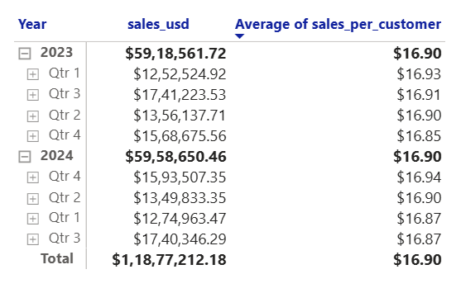
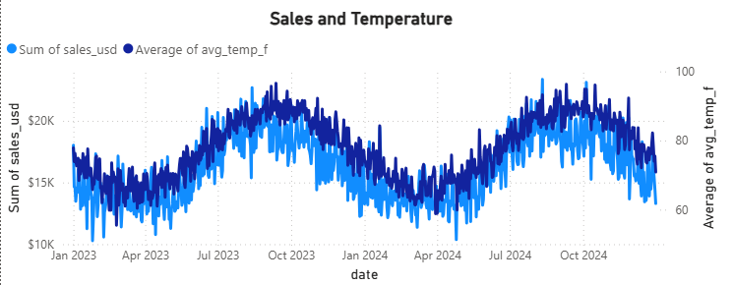
Recommendations
Sales are shaped by weather, location and customer mix. To maximise growth, managers must adapt operations to seasonal shifts and customer patterns. Staff and stock up during summer days because as the temperature increased sales increased as well.
During rainy days sales decreased hence, use lucrative discounts to attract customers
Miami is best selling, expand it during peak tourism months
Jacksonville is poor performing, run loyalty points or campaigns to ensure sales
Target families in weekends and singles on weekdays

